Slide 1
Community Detection in Social Networks
Purna Sai Pushkal Kalipindi
Maneesh Boddu

Slide 2
Agenda
01. Introduction
02. Girvan-Newman Algorithm
03. Process
04. Limitations & Future work
05. Demo

Slide 3
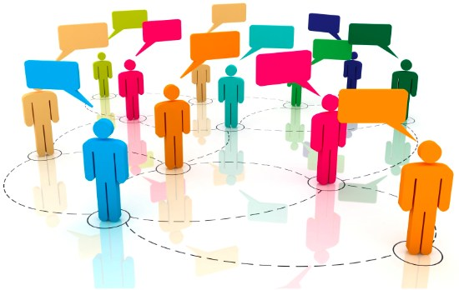
Introduction
Community detection refers to the procedure of identifying groups of interacting vertices in a network depending upon their structural properties.
It also refers as finding the group of people with similar interests in a vast community or world.
Results are based on Data, Algorithm, and what we looking for!
This Photo by Unknown Author is licensed under CC BY-SA-NC

Slide 4
Social Networks
A social network is a social structure made up of a set of social actors (such as individuals or organizations), sets of dyadic ties, and other social interactions between actors.
In Graphical Representation :
Nodes = Actors
Edges = Relationship
If there is a degree associated with the relationship, this degree is represented by labeling the edges. Often, social graphs are undirected, as for the Facebook friends graph

Slide 5
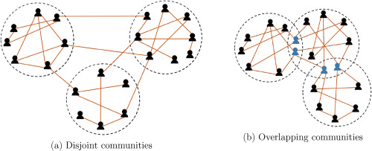
Communities
A community is a social unit (a group of living things) with commonality such as norms, religion, values, customs, or identity.
Types: 1) Disjoint
2) Overlapping
Dense group of vertices, which are tightly coupled to each other inside the one or more groups and loosely coupled to rest of the vertices in the network.

Slide 6
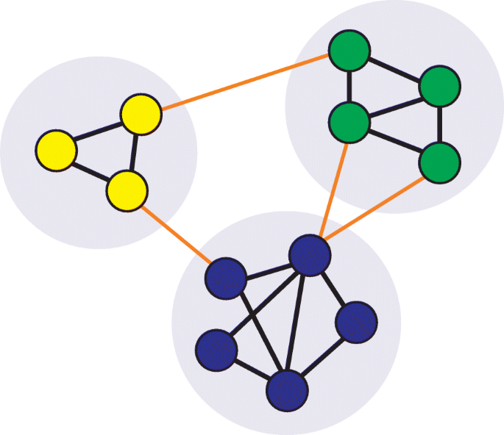
Community Detection
Community structure in social networks can give us clues about the nature of social interactions within the community represented.
It can be considered as a summary of the whole network thus easy to visualize and understand.

Slide 7
Why?
social network community are made up of interconnected nodes
It give us clues about the nature of social interactions within the community represented
Plays key role in understanding functionality of complex networks.
Sometimes, community can reveal the properties without releasing the individual privacy information.

Slide 8
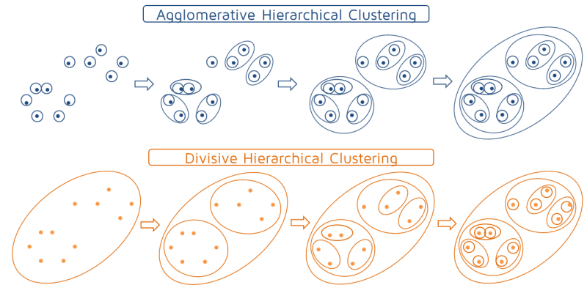
Traditional Approach
Agglomerative method
It follows Bottom-up approach.
It considers all nodes as a separate cluster and iteratively merge them based on high similarity, which in result ends with unique community
Divisive method
It follows Top-down approach
Initially, it considers the entire network as single cluster. Then iteratively splits graph into partitions by eliminating links joining nodes with low similarity and ends up with unique communities

Slide 9
Girvan-Newman Algorithm
The Girvan–Newman algorithm detects communities by progressively removing edges from the original network.
The Girvan–Newman algorithm extends this definition to the case of edges, defining the "edge betweenness" of an edge as the number of shortest paths between pairs of nodes that run along it.
The algorithm's steps for community detection are summarized below
The betweenness of all existing edges in the network is calculated first.
The edge(s) with the highest betweenness are removed.
The betweenness of all edges affected by the removal is recalculated.
Steps 2 and 3 are repeated until no edges remain.

Slide 10
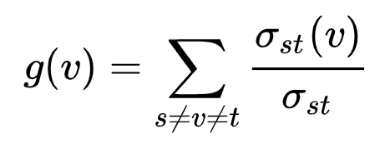
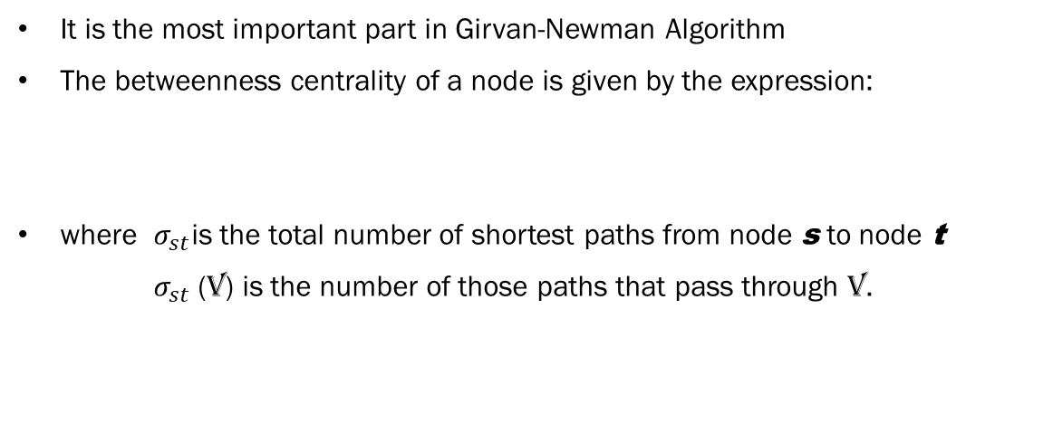
Edge Betweenness centrality
It is the most important part in Girvan-Newman Algorithm
The betweenness centrality of a node is given by the expression:
where $σ_{st}$is the total number of shortest paths from node s to node t
$σ_{st}$(v) is the number of those paths that pass through v.

Slide 11
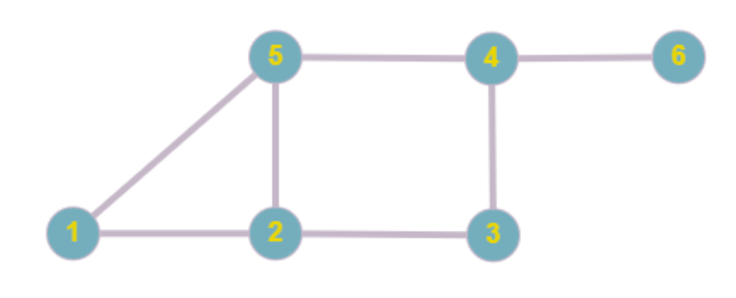
Example
The edge betweenness for the graph is defined as:
Edge | Betweenness
12 | 2
15 | 3
23 | 3
25 | 2.5
34 | 3.5
45 | 5.5
46 | 4.5
For example: for edge 46, the summation in order of
=12 + 13 + 14 + 15 + 16 + 23 + 24 + 25 + 26 + 34 + 35 + 36 + 45 + 46 + 56
=0/1 + 0/1 + 0/1 + 0/1 + 1/1 + 0/1 + 0/2 + 0/1 + 1/2 + 0/1 + 0/2 + 1/1 + 0/1 + 1/1 + 1/1
= 0 + 0 + 0 + 0 + 1 + 0 + 0 + 0 + 0.5 + 0 + 0 + 1 + 0 + 1 + 1
= 4.5

Slide 12
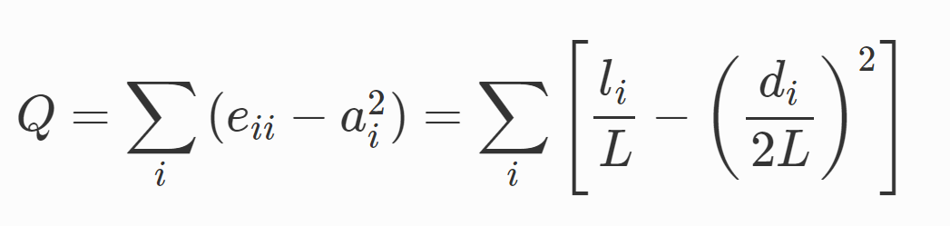
Modularity
A quantitative measure of the modularity of a complex network was introduced by Newman and Girvan
Measures the quality of given community structure
i : number of communities
Li: Total number of links in community c
L: Total number of links
di: Total node degrees in community c

Slide 13
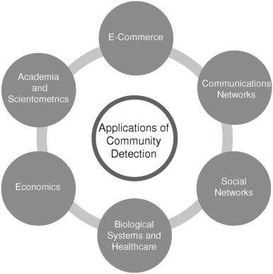
Applications
Community Detections are used in every field like
E-Commerce
Social Networks
Communication Networks
Academia and Scientometrics
Economics
Healthcare Systems

Slide 14
Limitations
Not time efficient for large number of nodes and data.
Tends to give relatively poor results for dense networks.
For community partition by betweenness not possible to place individual in two different communities and everyone is assigned to community.
It provides no guide to how many communities a network should be split into i.e. where to cross-cut.

Slide 15
Future Work
By improved Girvan-Newman method where multi edge removal is allowed.
It reduces number of operations by retaining the same computational complexities.

Slide 16
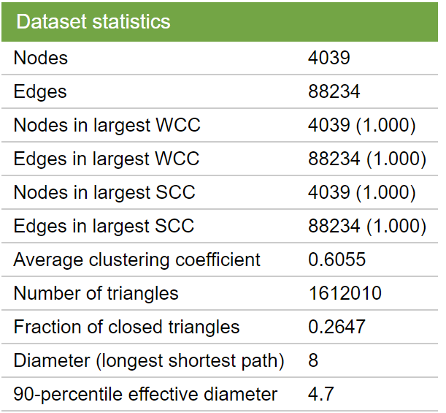
Datasets

Slide 17
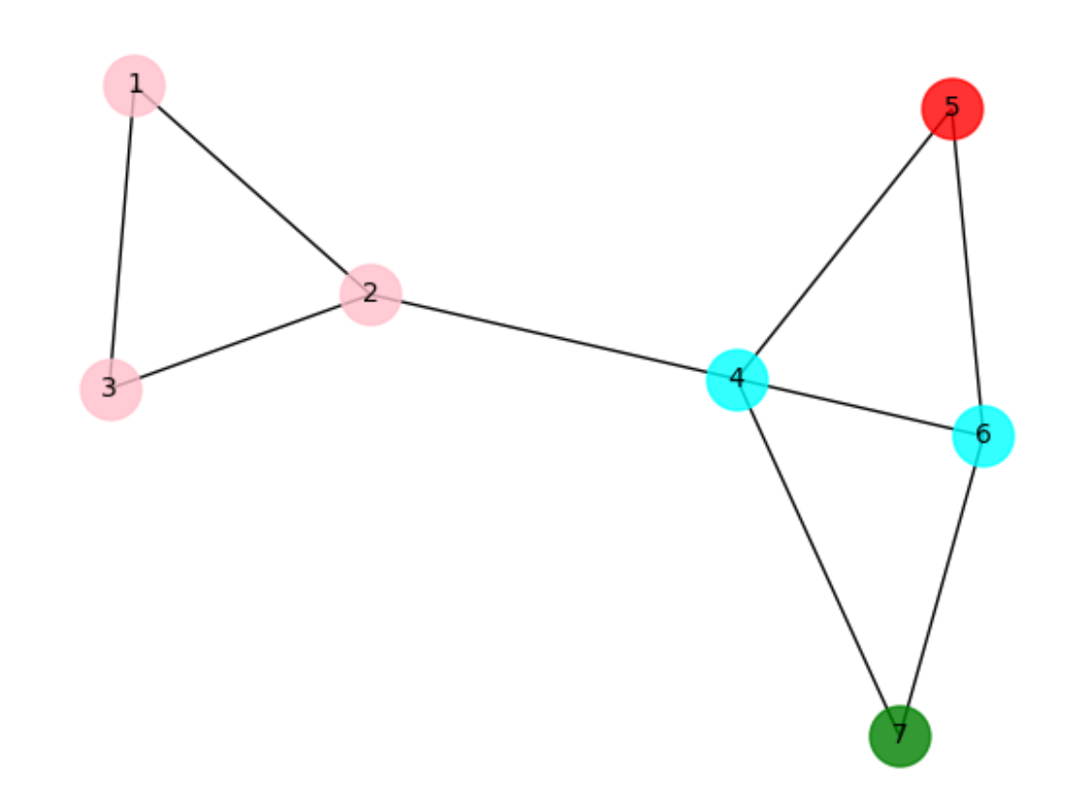
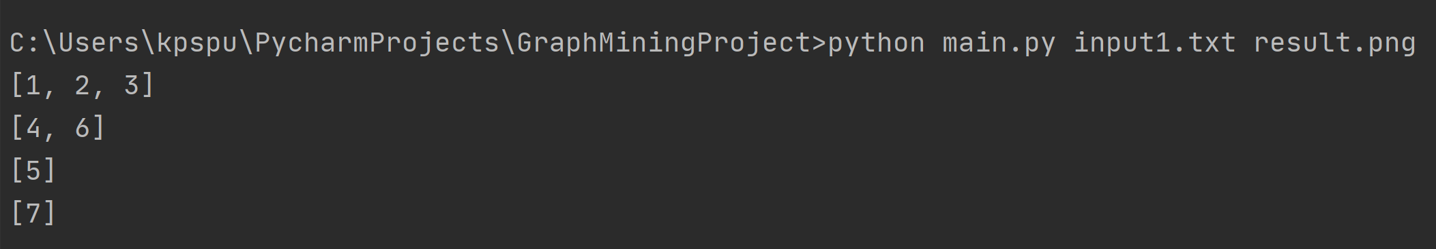
Results

Slide 18
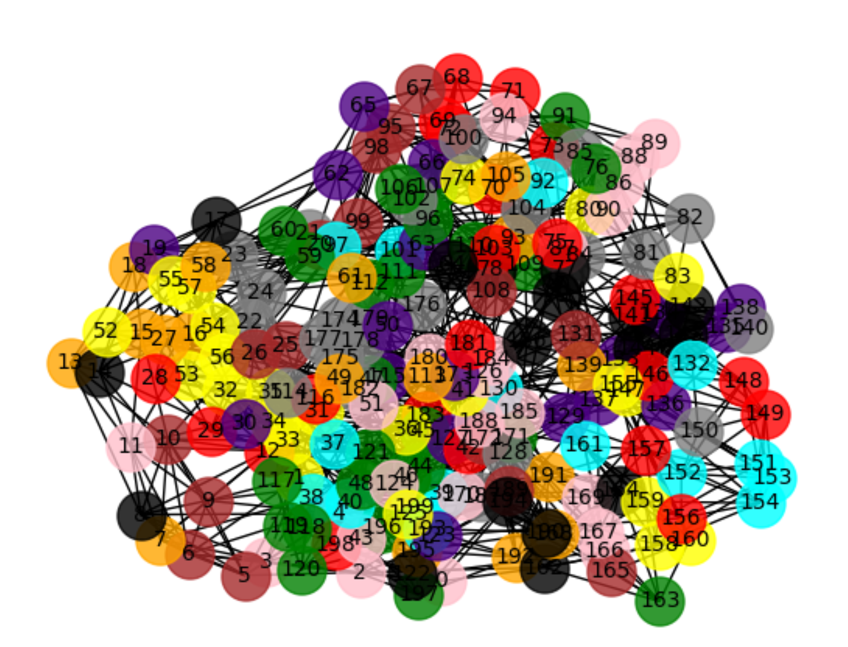
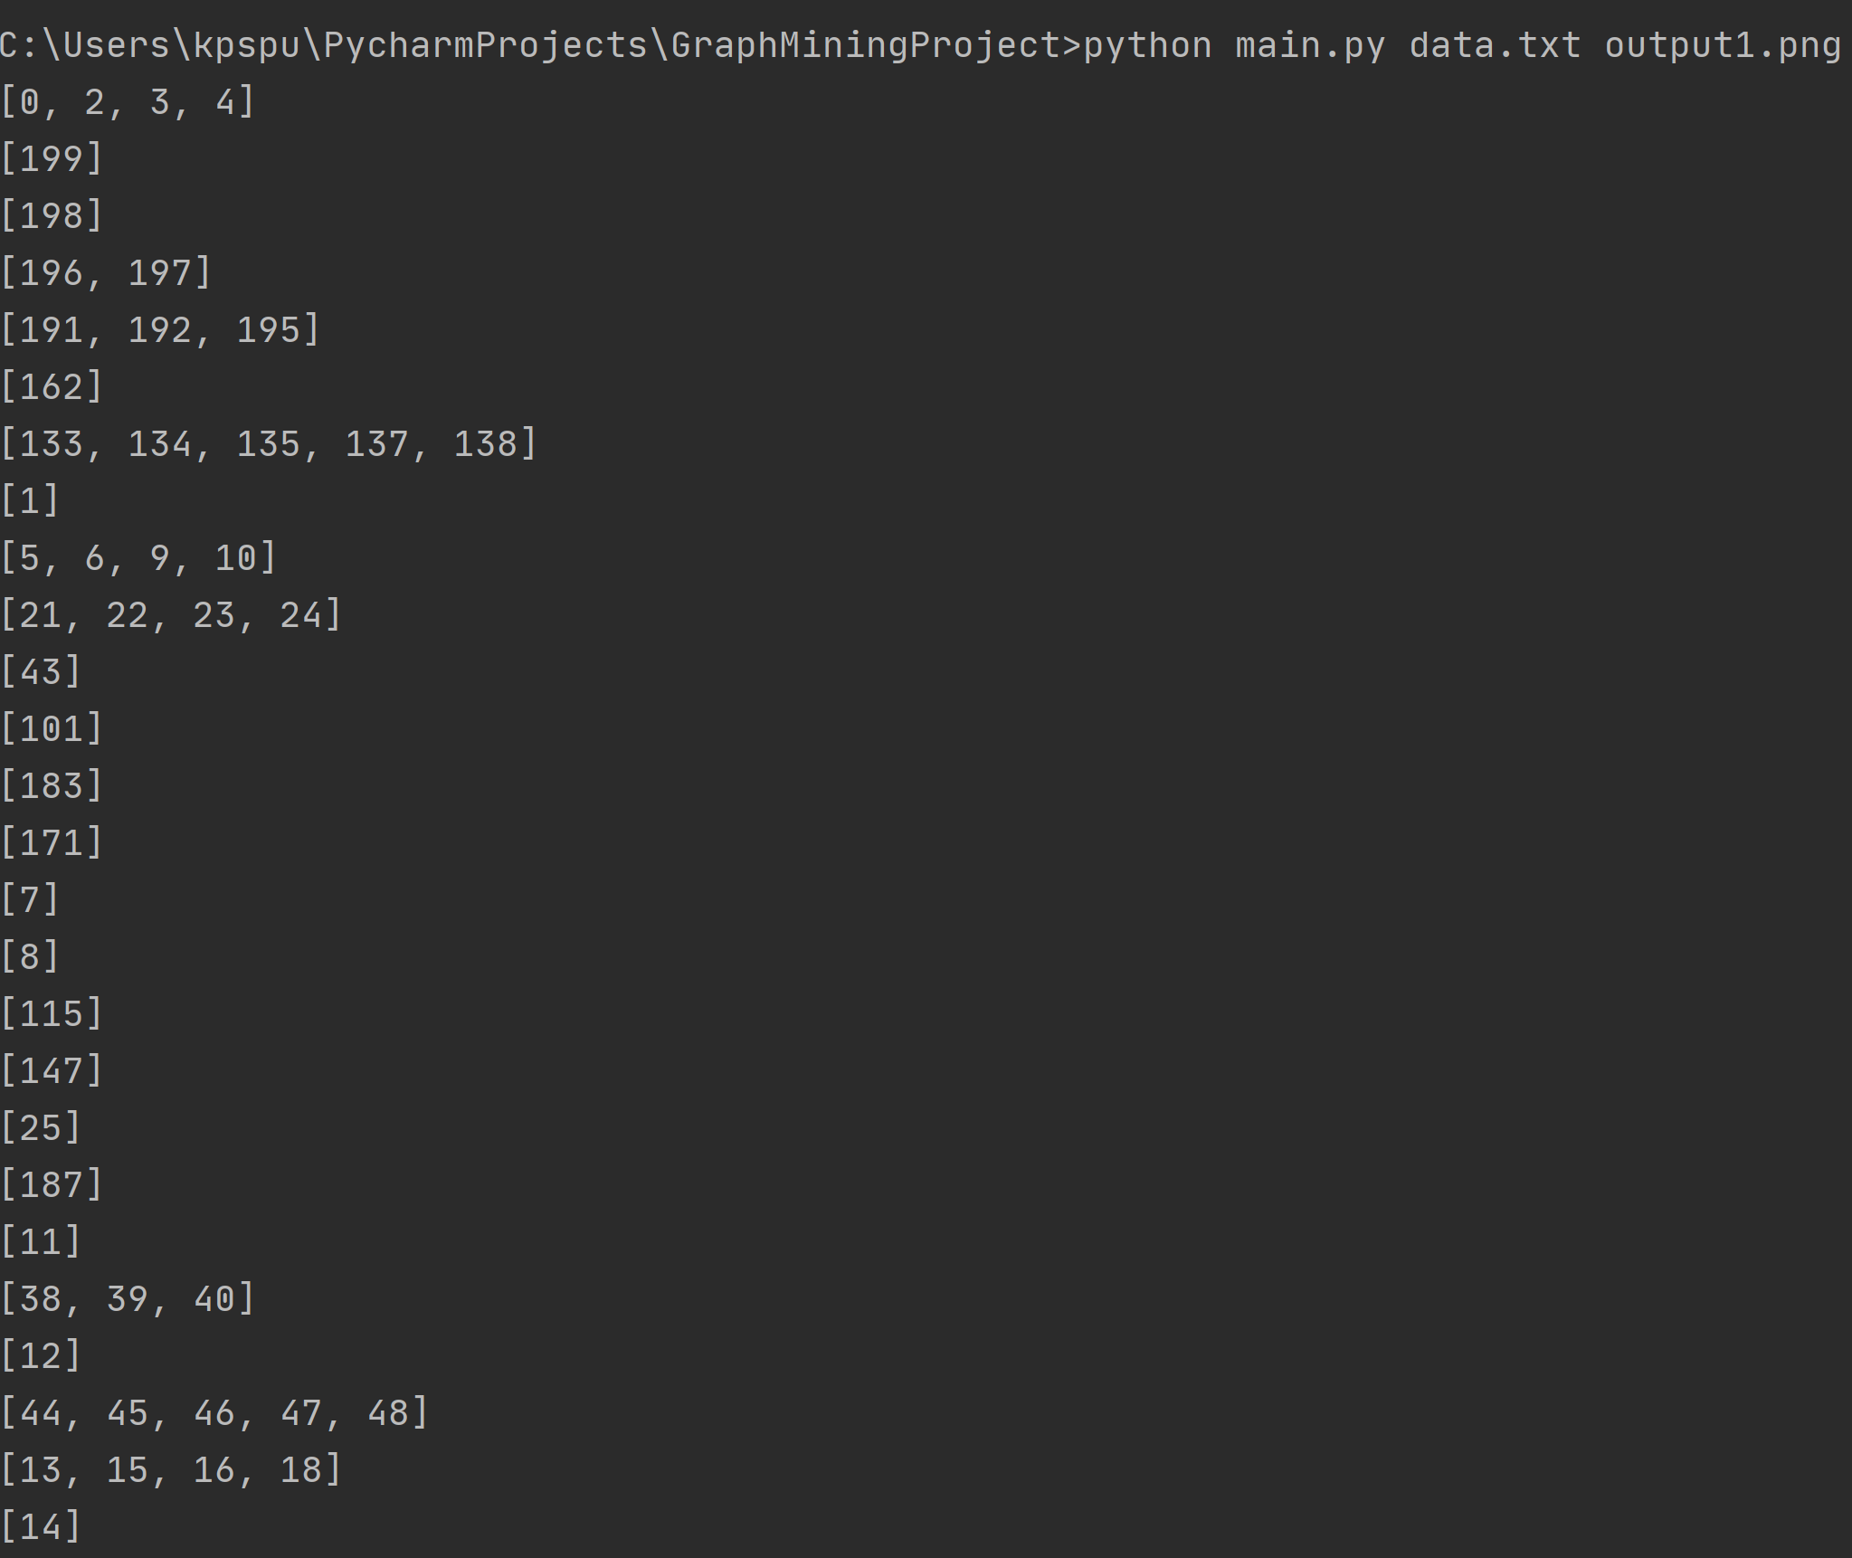
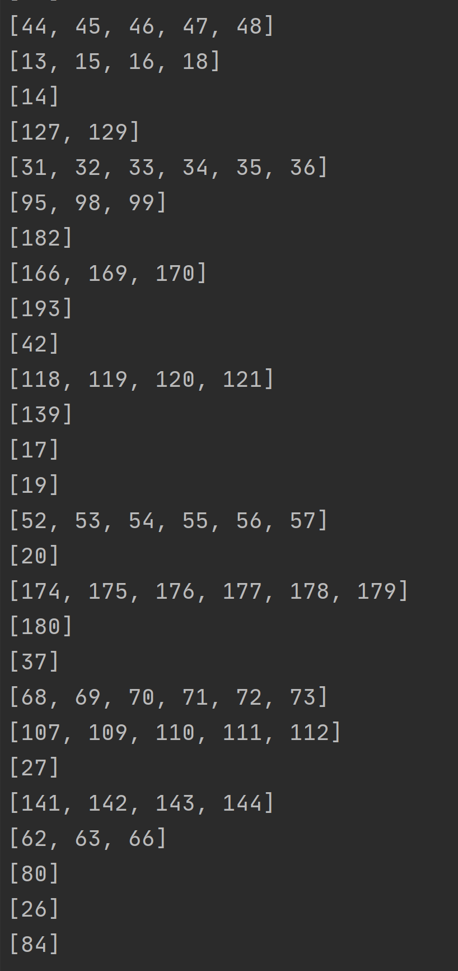
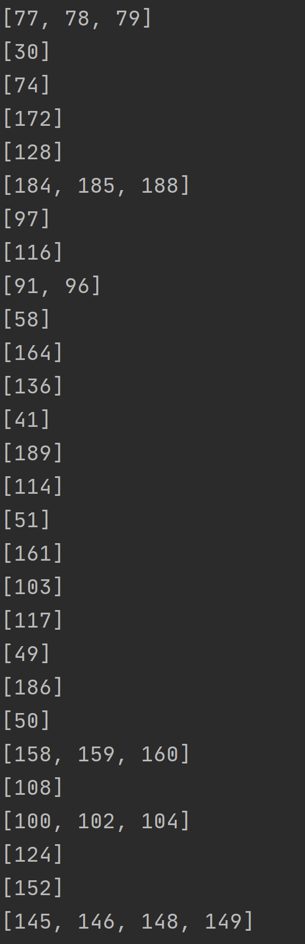
Results

Slide 19
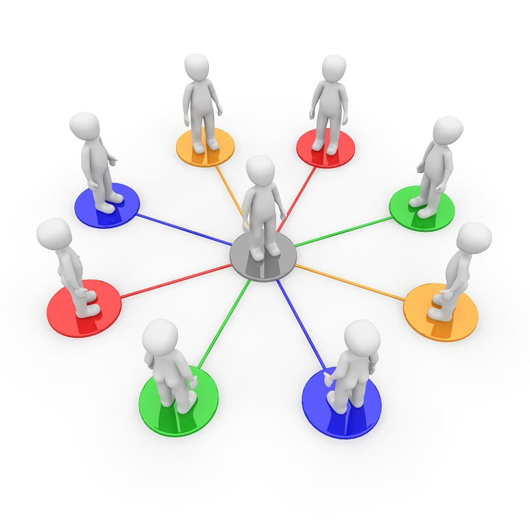
DEMO

Slide 20

Thank you

